Slide 1
National Association of Railway BusinessWomen
www.NARBW.org

Slide 2
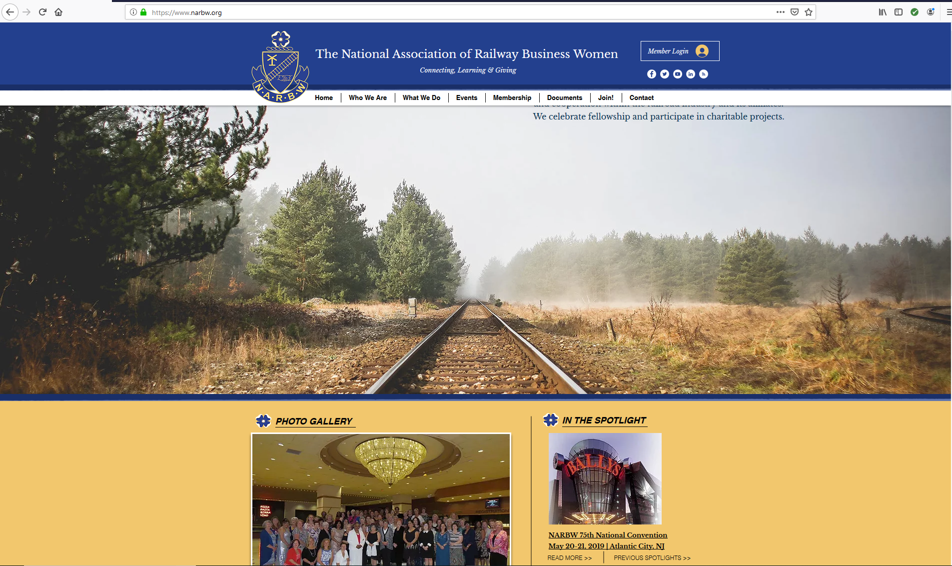
When logging on to the website it will bring you to the HOME PAGE. Navigate through the website by using the scroll bar on the right hand side of your screen or by clicking on the menu bar at the top center of your screen. SCROLL DOWN You will see the Photo Gallery, Our Purpose, In The Spotlight, Welfare Warriors & Presentations. The most recent posts are shown on the Home Page. You will see the most recent national Presidents here on the Home Page and a link to view the page for the Hall of National Presidents At the Very Bottom of the Home Page there are Quick Links to some of the website pages and social media links.

Slide 3
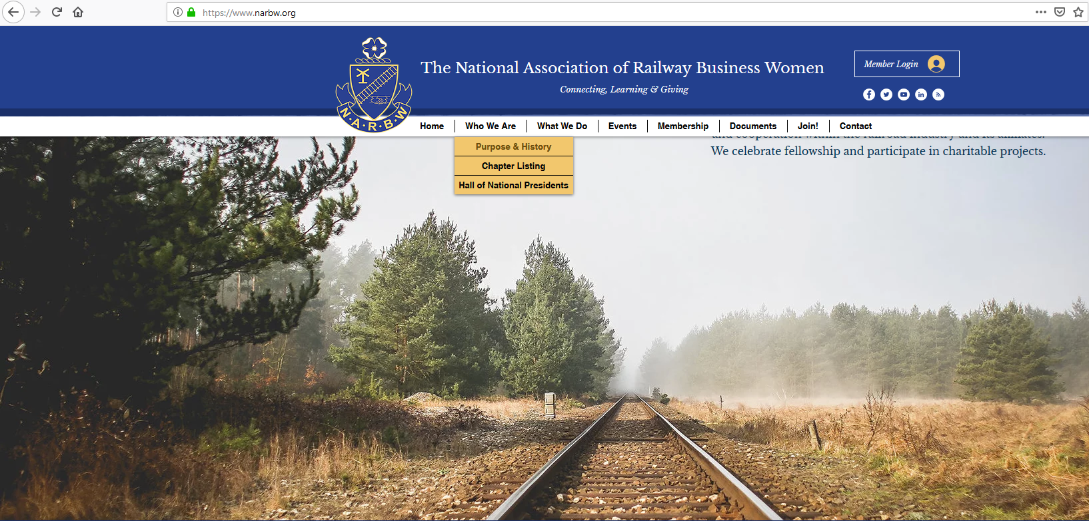
Who We Are
Purpose & History
This page will give you the NARBW Purpose & the History of the Organization
Chapter Listing
This page will give you a list of all active chapters in the organization. Click on a chapter and it will give you a brief description of the chapter’s established date, email contact link, meeting times, current chapter president and a small description of chapter activities.
Hall of National Presidents
Here you can view the photos of all the national presidents. Scroll over the photo and their name , chapter and year of service is listed.

Slide 4
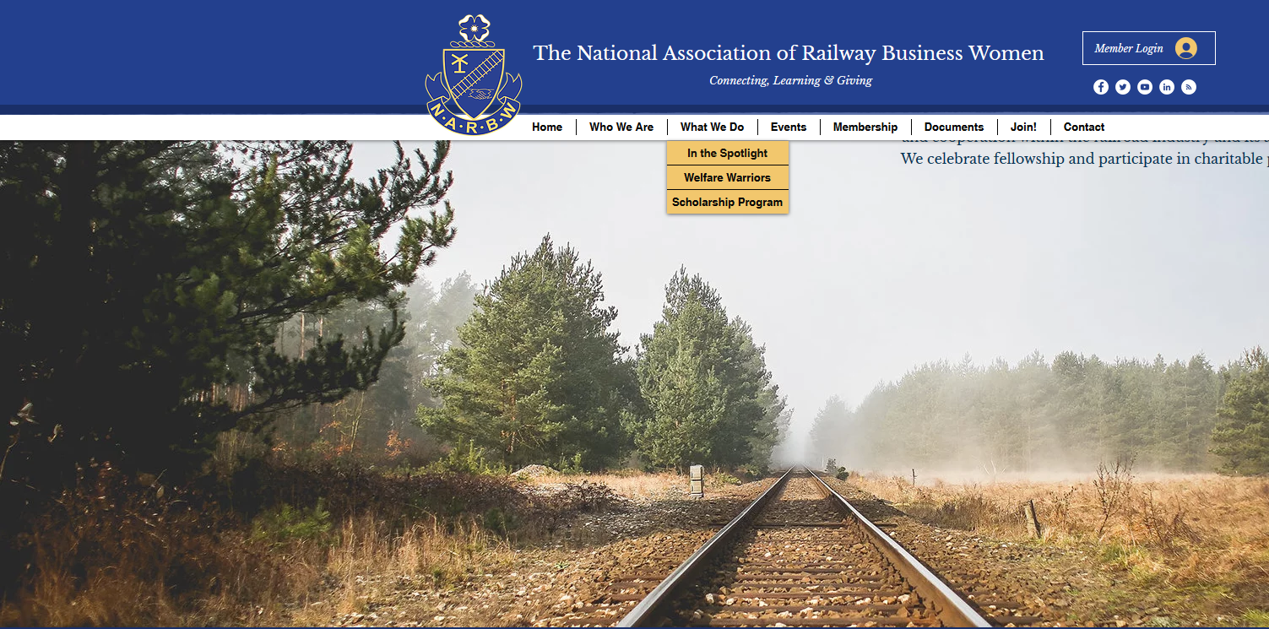
What We Do
Scholarship Program
This page will show you the photos of the most recent National Scholarship Winners. If you click on their photo it will also give you a brief description about the winners that was read at the National Convention.
The Scholarship page will also give you a description about the program and a link for the scholarship application

Slide 5
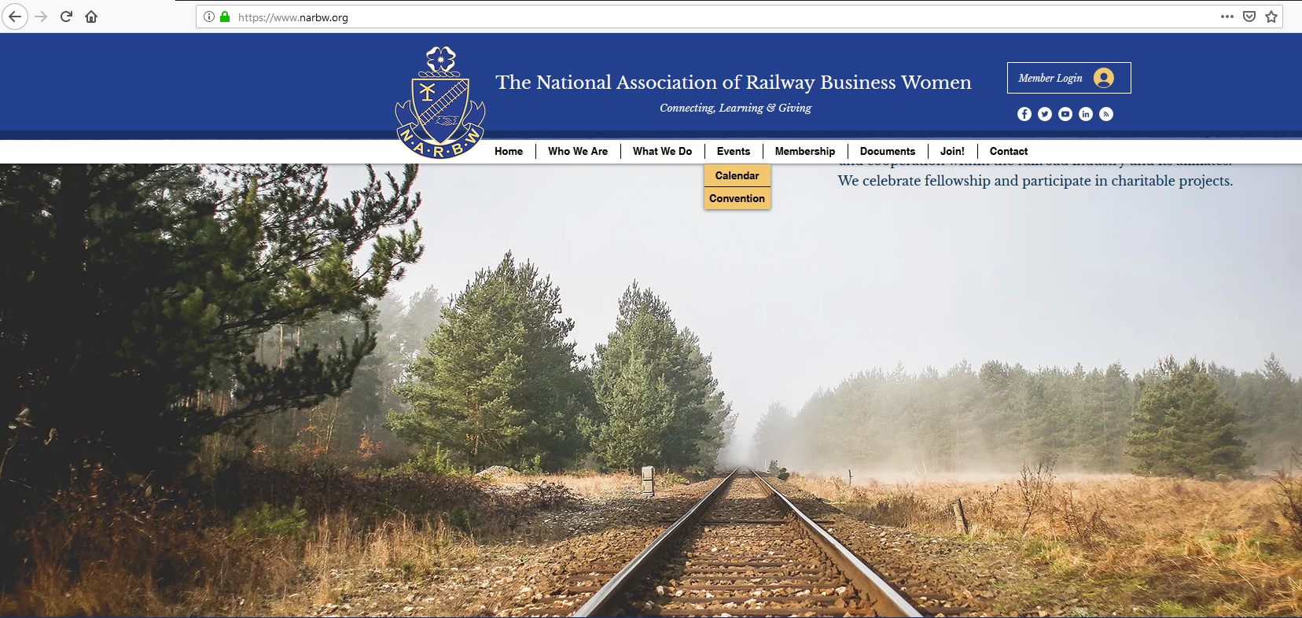
Events
Calendar
On this page you will find the national calendar with upcoming dates and announcements.
Convention
This page will give you all the convention information needed for the next National Convention. Links to Forms and the most recent Photo Gallery of Convention Photos will be posted on this page.

Slide 6
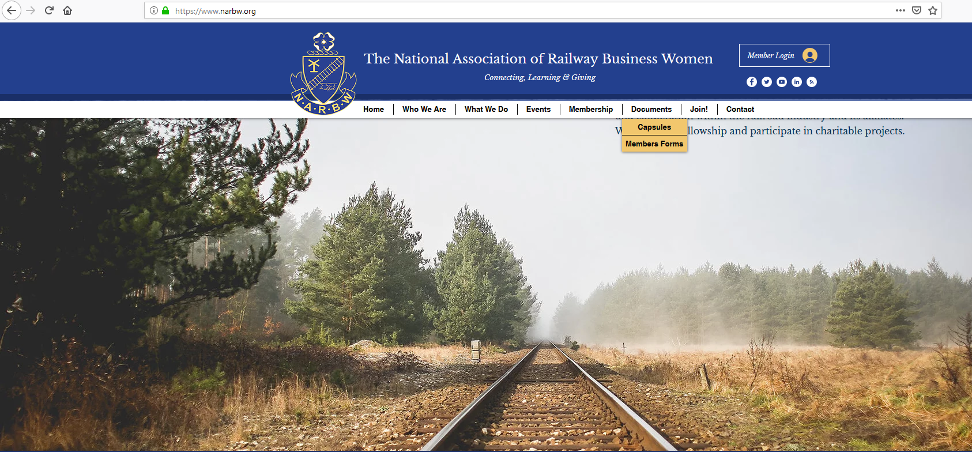
Documents
Capsules
The page will give you access to all the published national quarterly capsules. Scroll down a little more and any historical documents you can find here as well.
Members Forms
If you are being asked to enter in a Password in the Guest Area, the Members Only Password is CORNELL (all caps)
All member Documents are posted under members Forms. National Constitution & Bylaws, Convention Books & Photos, National Operating Budget, Forms, Handbooks, Membership & Officer Rosters, marketing Materials, and Plans of Work & Reports.
Presentations
Click here to find our presentations

Slide 7
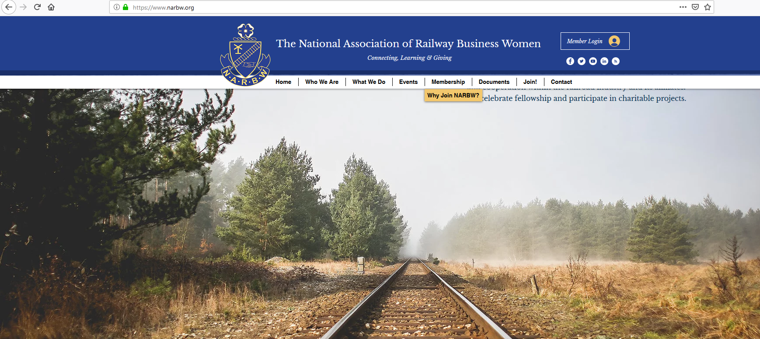
Membership
Why Join NARBW
This page gives readers the purpose of the organization, member testimonials, and the types of memberships that are offered by the organization.
There is a link to the NARBW Brochure for the readers convenience. Scroll down a little more and find two simple steps to join.

Slide 8
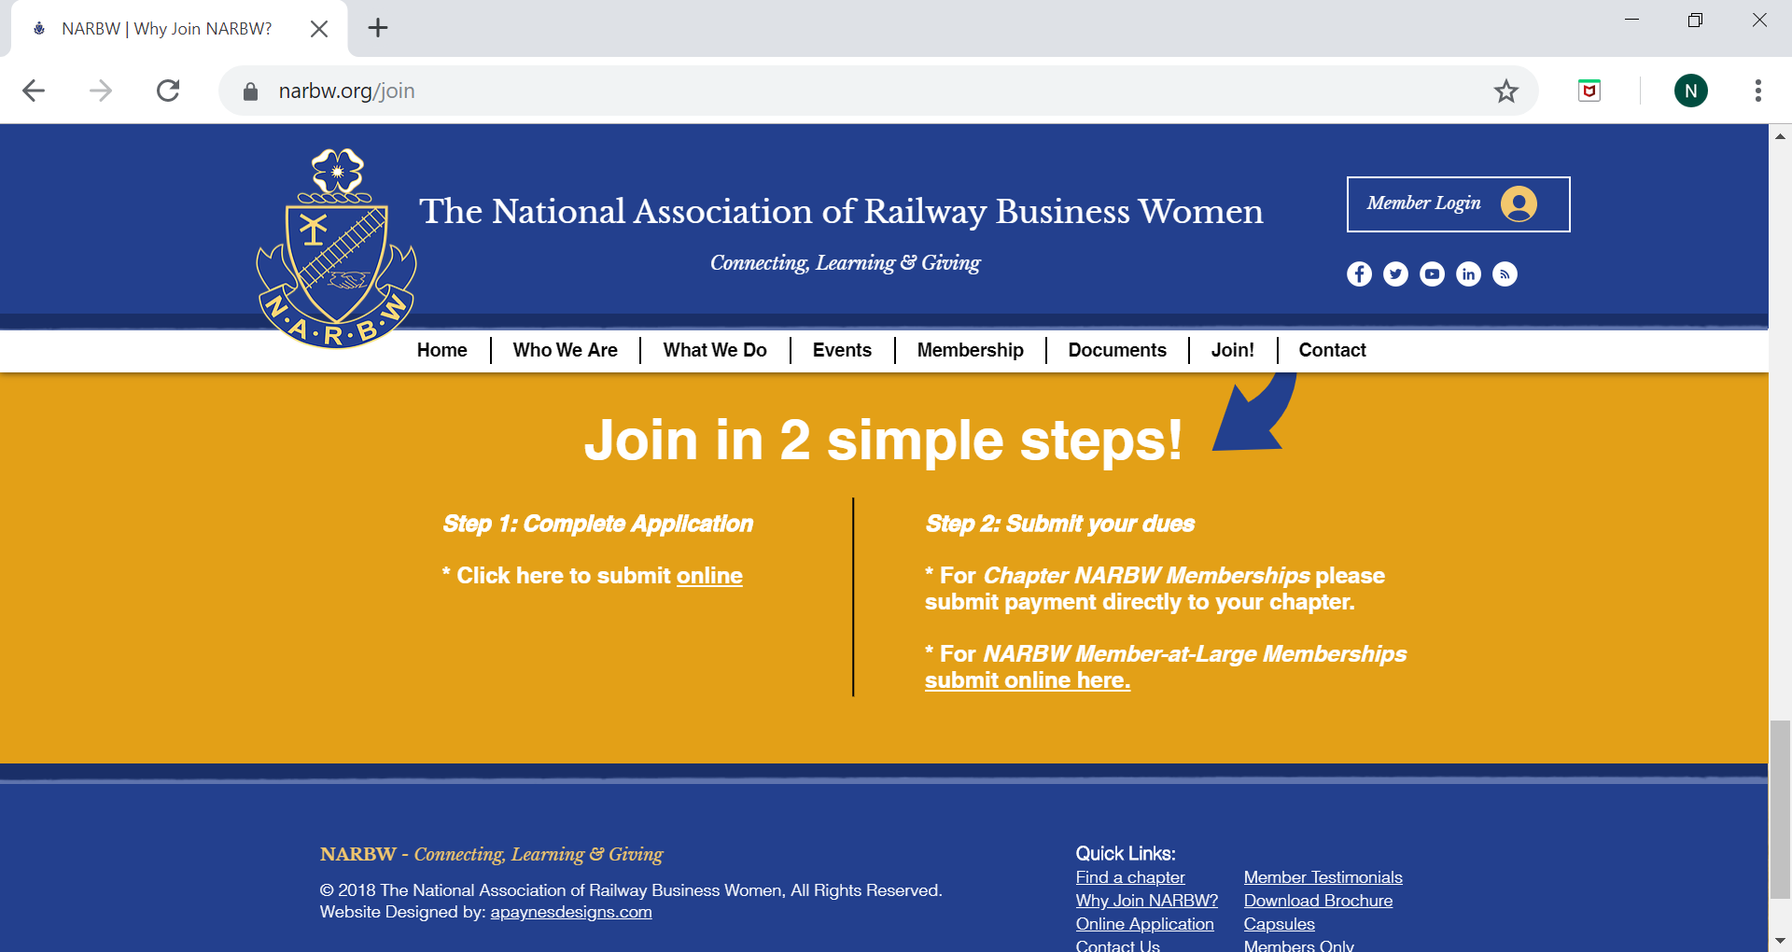
Join
Step 1: Complete an online application
Step 2: Submit your dues (to the local chapter) or for member-at-large submit payments on-line.

Slide 9
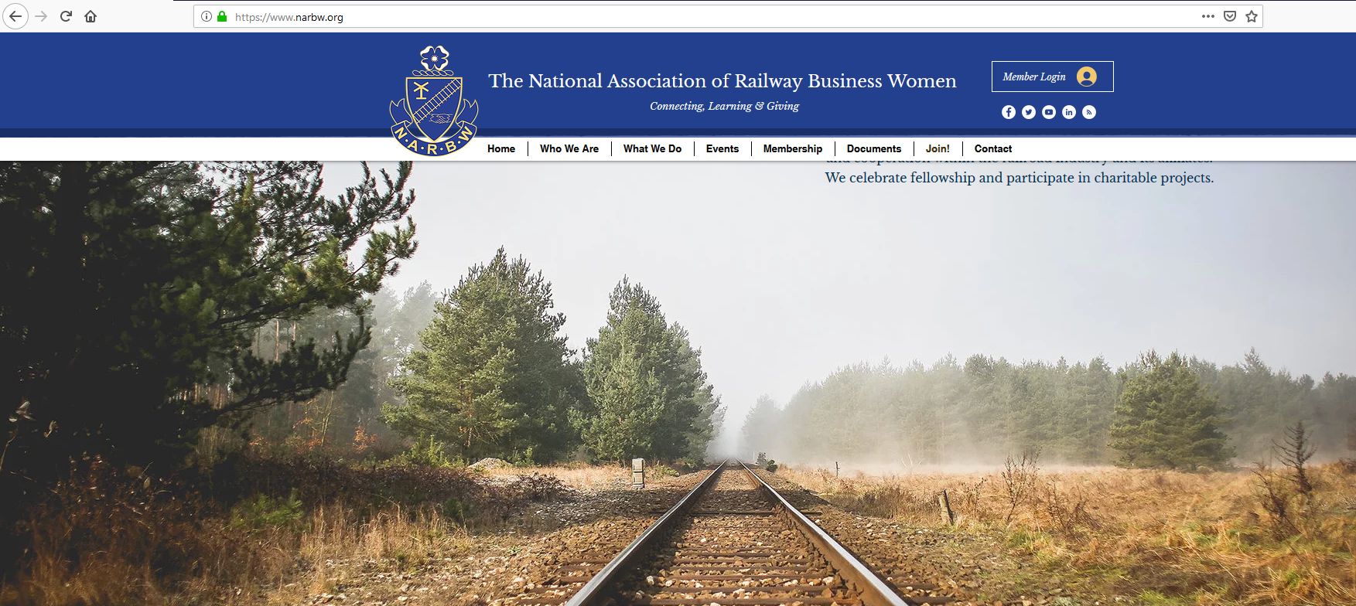
Contact
This page will allow you to send an email to national with your questions or comments.
You will also see that the live Facebook social media page for national is also visible.

Slide 10
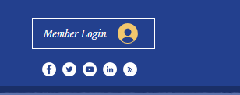
Social Media Links
In the Upper right-hand corner of the home page you see circles with the social media symbols. These are all the National NARBW social media links. Click to access these accounts.
Remember these same links are always located at the bottom of each website page.
Facebook
Twitter
YouTube
Linked in
FeedBurner

Slide 11
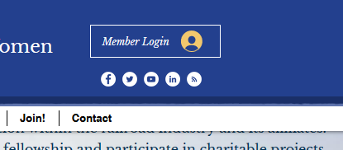
Members Login
The Members Profile page is a membership database just for NARBW Members Only.
If you are new to the Members Profile Page,
click the orange link that says sign up
New to this site? Sign Up
Once you sign up, National will review your request and approve your request.
If you have already signed up for this site with your personal email address and password, enter that information in and click Log In

Slide 12
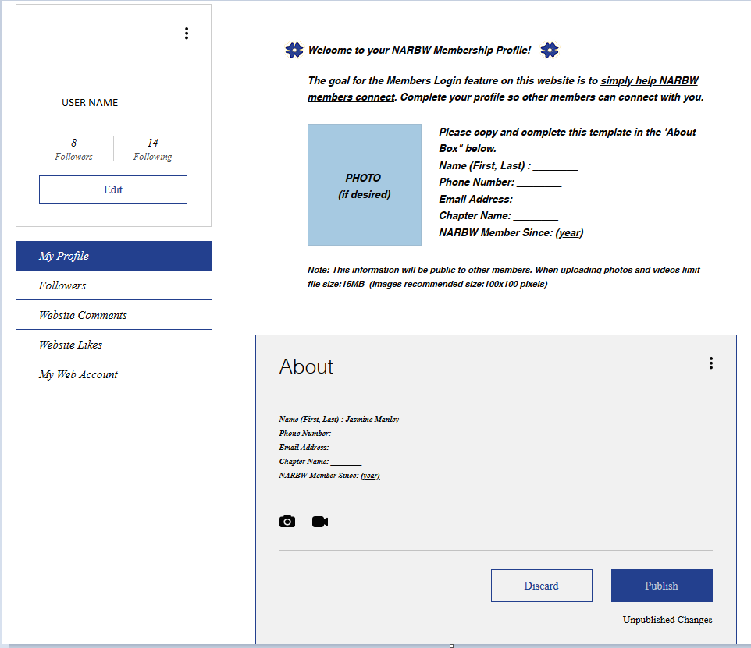
Membership Profile
The directions on this page will direct you on how to complete the about section of your profile page.
Feel free to add anything you want your followers to know about you, including posting pictures and videos of your choice.

Slide 13
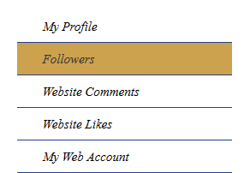
Membership Profile
FOLLOWERS
Review this page to see the NARBW Members you are following and who is following you.
You can click on their profile and view their profile page

Slide 14
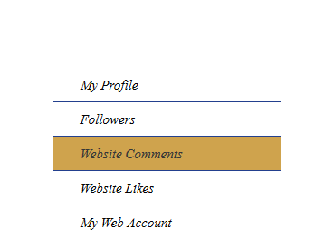
Membership Profile
WEBSITE COMMENTS
Review this page to see what NARBW website comments you’ve made

Slide 15
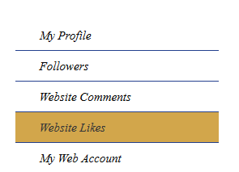
Membership Profile
WEBSITE LIKES
Review this page to see what NARBW web pages you’ve liked

Slide 16
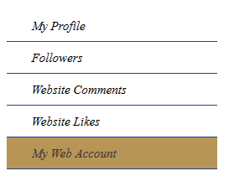
Membership Profile
MY WEB ACCOUNT
Here is where you can update your information for the NARBW website that will filter to the NARBW DATABASE

Slide 17
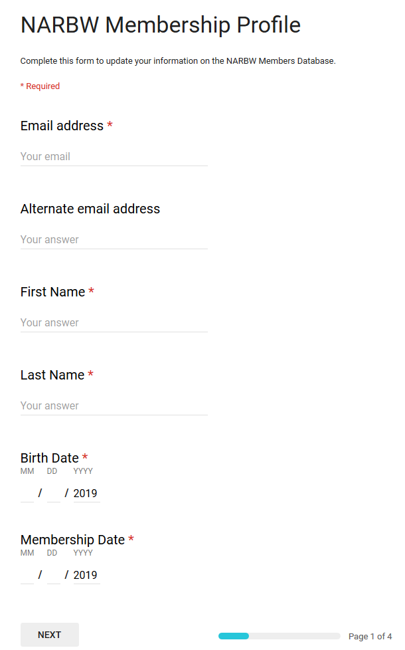
Membership Profile
UPDATE NARBW DATABASE
Here you can update your membership profile information in detail as if you were filling out information for joining.

Slide 18
Membership Profile
MEMBERS FORMS
Just a quicker way to access members forms from the membership profile page so you won’t have to go back to the documents tab above and enter the generic password CORNELL

Slide 19
Membership Profile
LATEST MEMBERSHIP ROSTER
HERE YOU WILL BE ABLE TO VIEW THE NATIONAL ROSTER BY CHAPTERS OF ALL ACTIVE MEMBERS.

Slide 20
NARBW Website Contact Information
www.publications@NARBW.org
www.publication@NARBW.org

