Slide 1
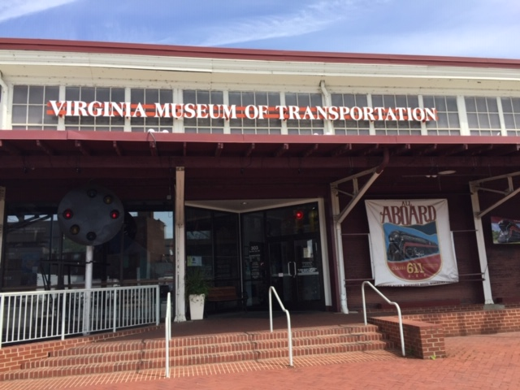
VIRGINIA MUSEUM OF TRANSPORTATION ROANOKE, VA

Slide 2
NARBW has a display of our history

Slide 3
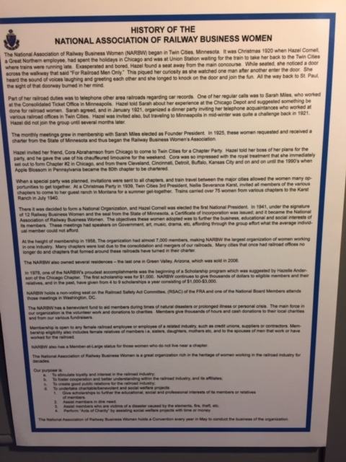

Slide 5
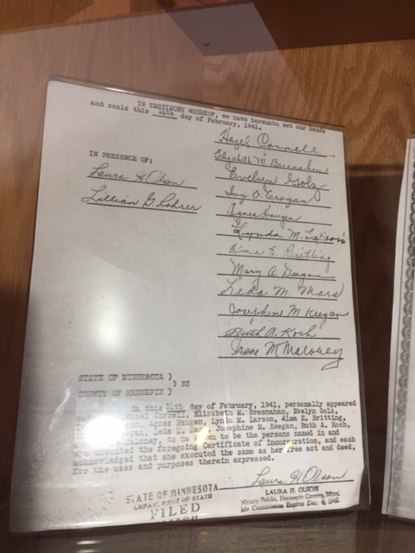

Slide 6
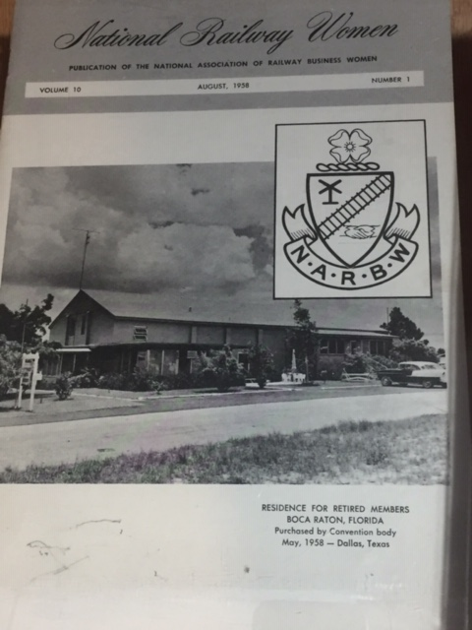

Slide 7
NATIONAL RAILWAY WOMEN
– PUBLICATION DECEMBER 1954
PLAN TO ATTEND –
NATIONAL CONVENTION IN CHICAGO, MAY 24-26, 1955 AT LASALLE HOTEL

Slide 8
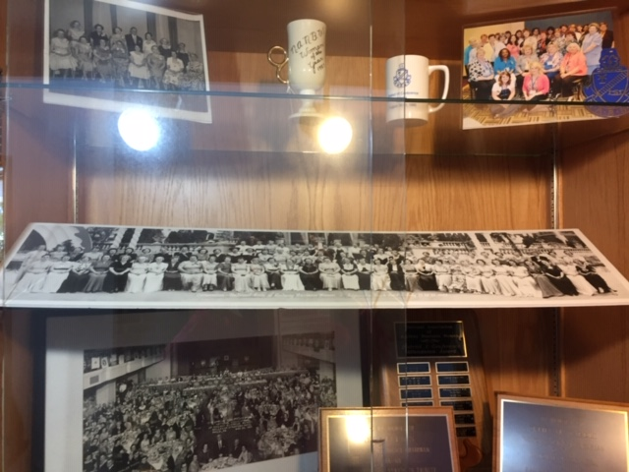

Slide 12
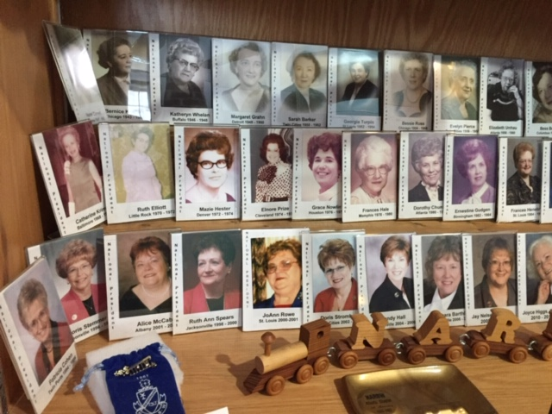

Slide 13
